Slide 1
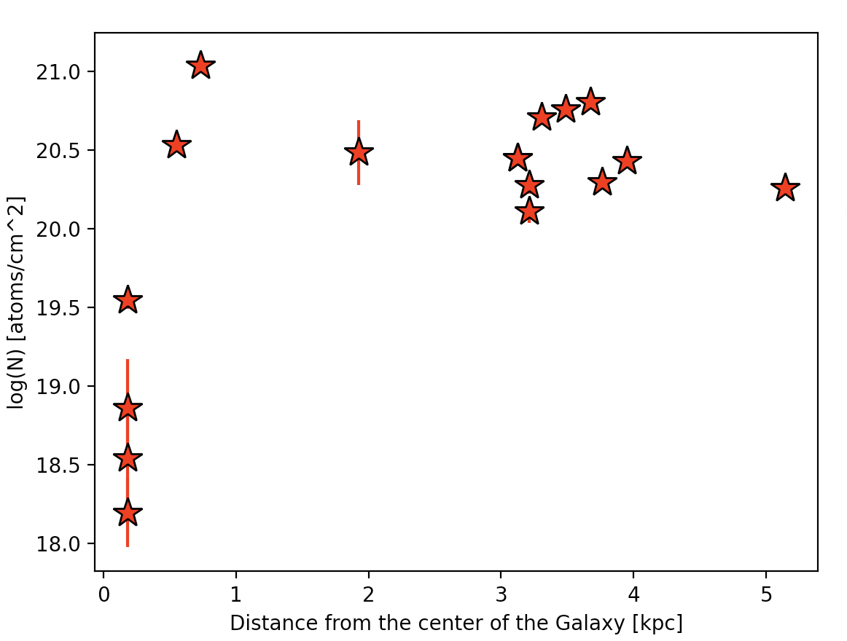

Slide 2
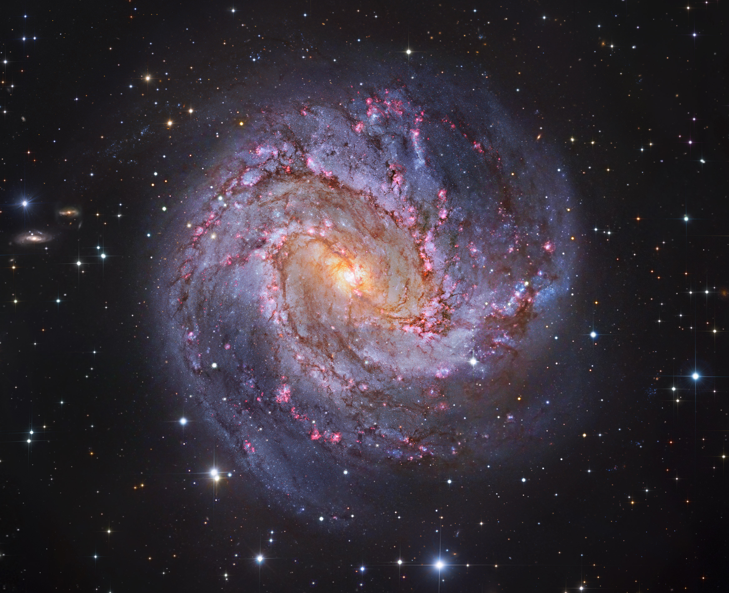
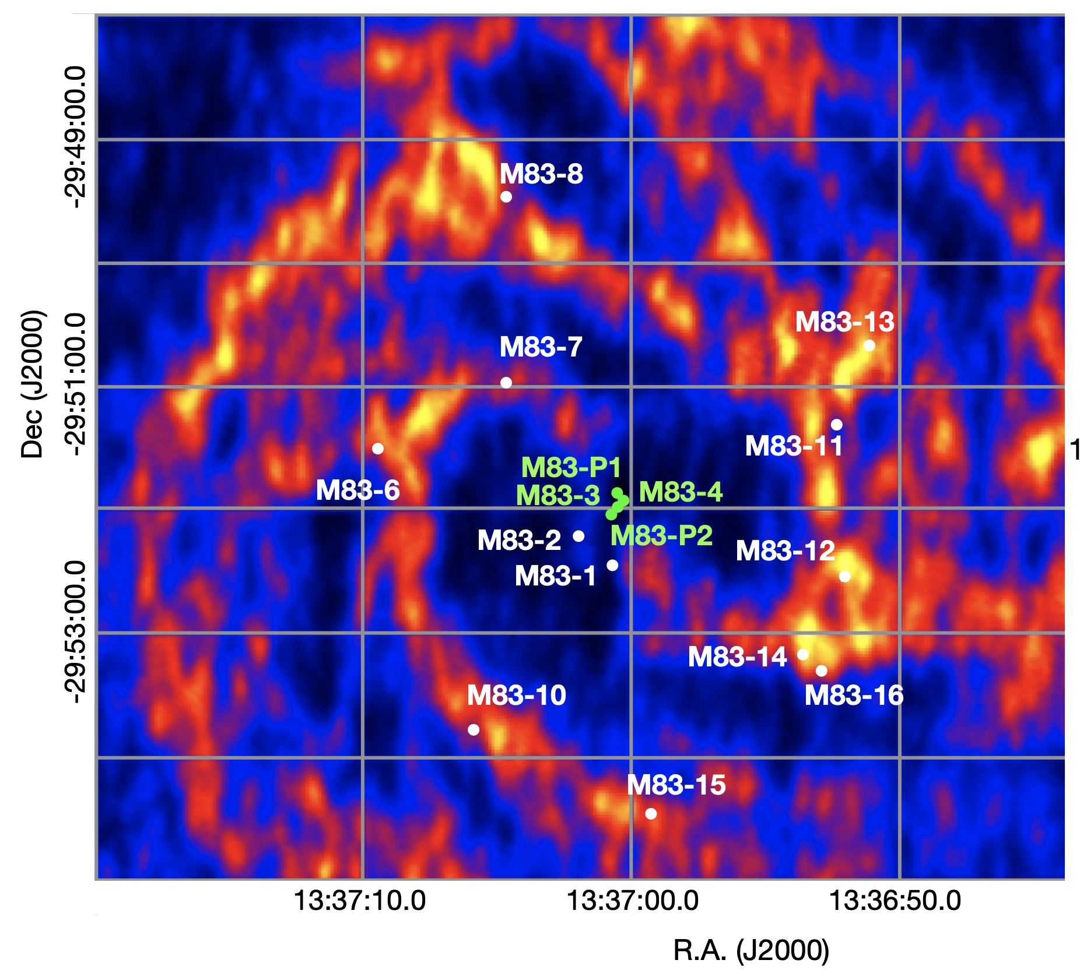
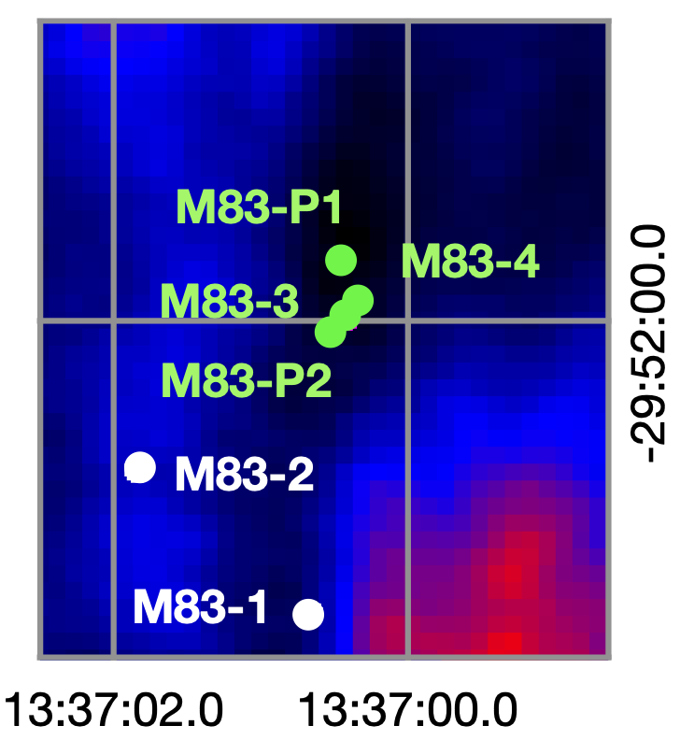
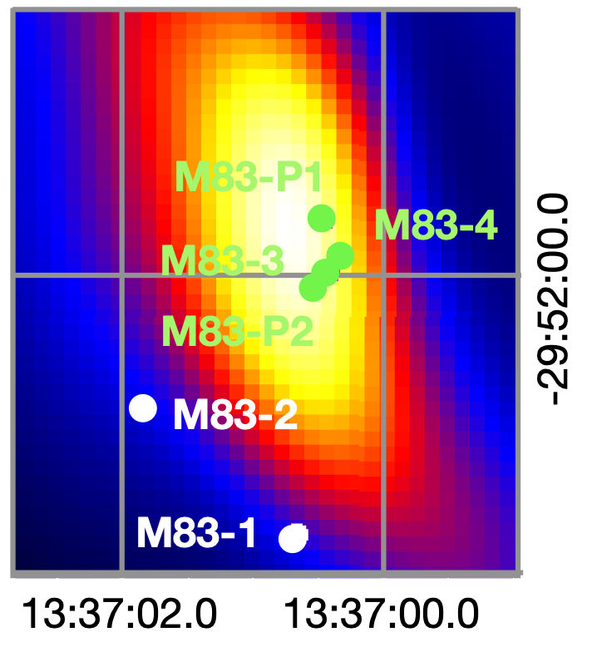
HI
Gas
M83-9
Molecular
Gas

Slide 3
The most natural explanation would be the conversion of atomic/neutral gas to molecular gas. This molecular gas ends up fueling the star formation activity.
Excavation by galactic winds.

Slide 4
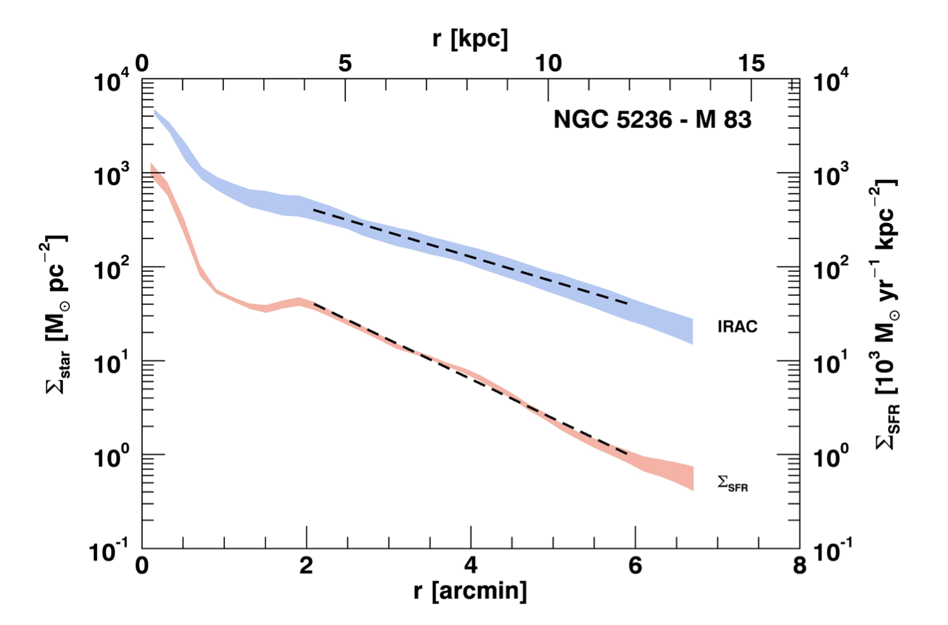
1 pc = 3.26 light-years
Casasola et al. (2017)

